Slide 1
Whatsapp Clone
By ankan pal(A-07),Nilabhra Adhikari(a-57)
In this presentation we will take you through all the features of our android application and details about it. It will be a full featured application with reactions using android Studio, Firebase Realtime Database and Java.

Slide 2
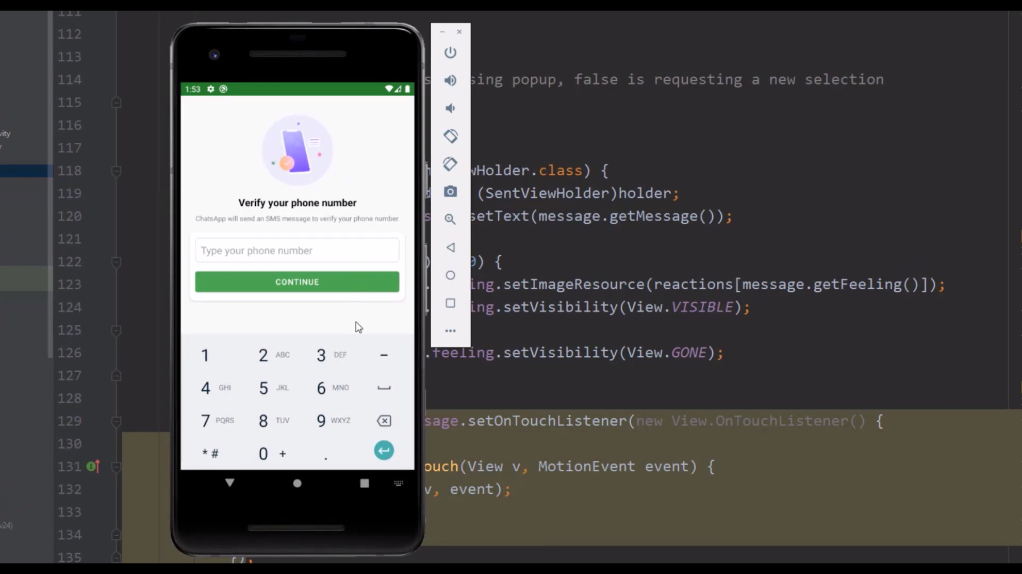
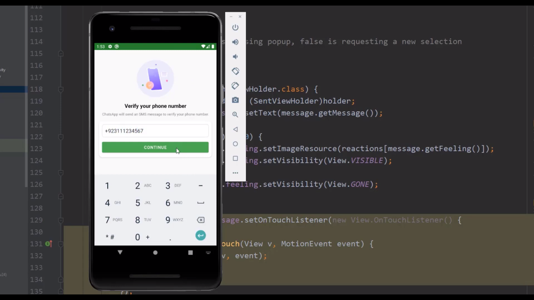
As a new user, the first screen will appear as
Enter your number for verification and click on continue

Slide 3
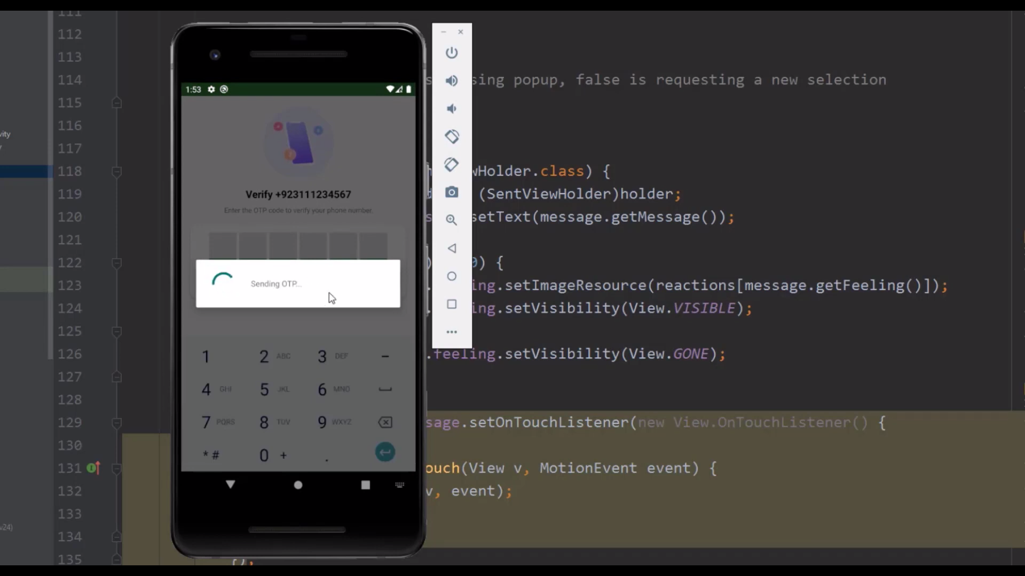
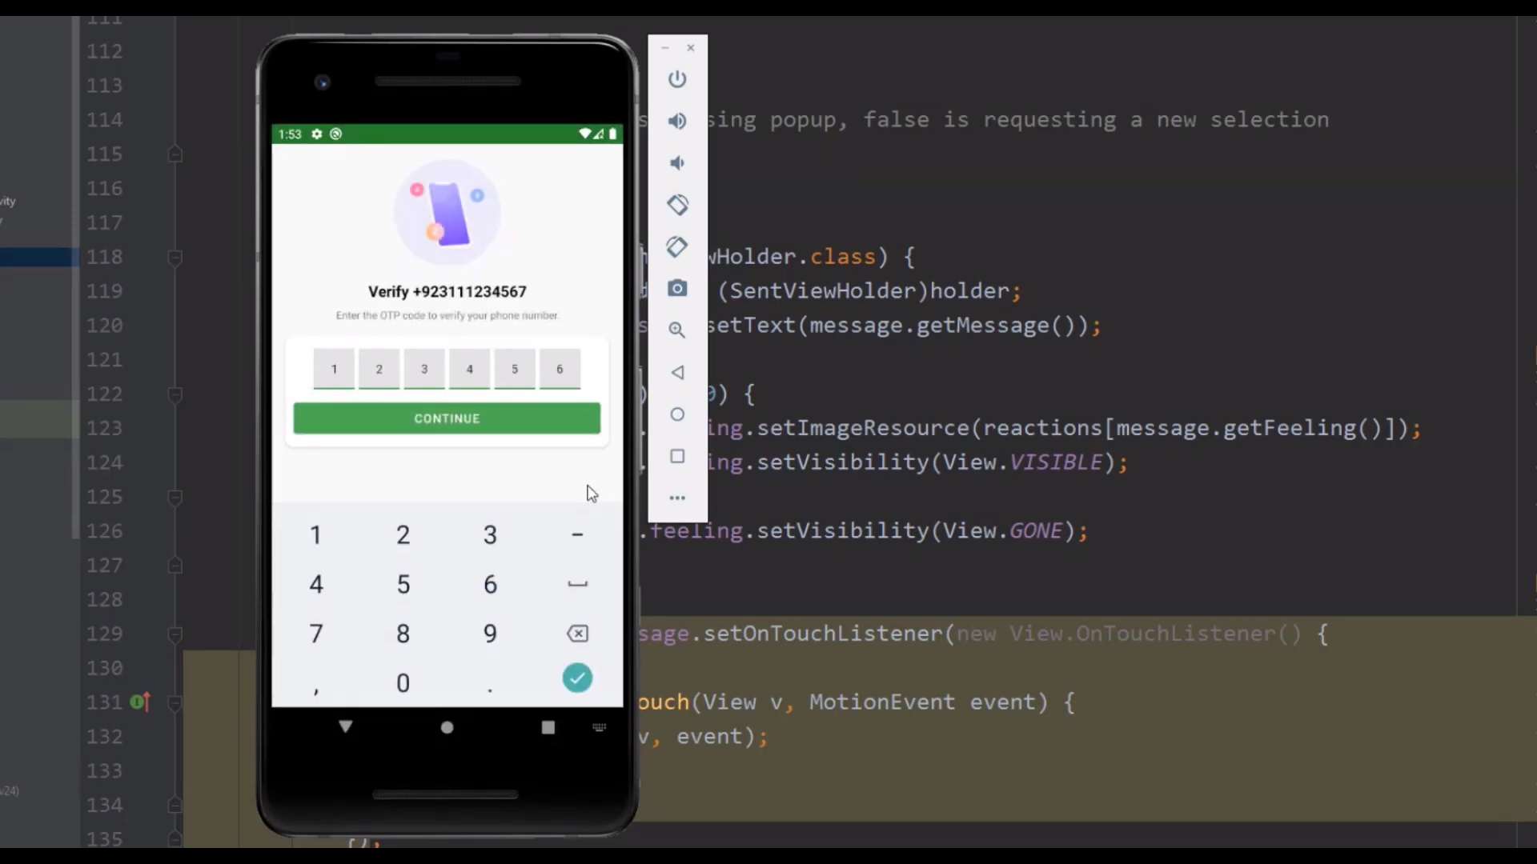
Now an OTP will be sent in the number for verification purpose.
Now you have to enter the same OTP and click on Continue

Slide 4
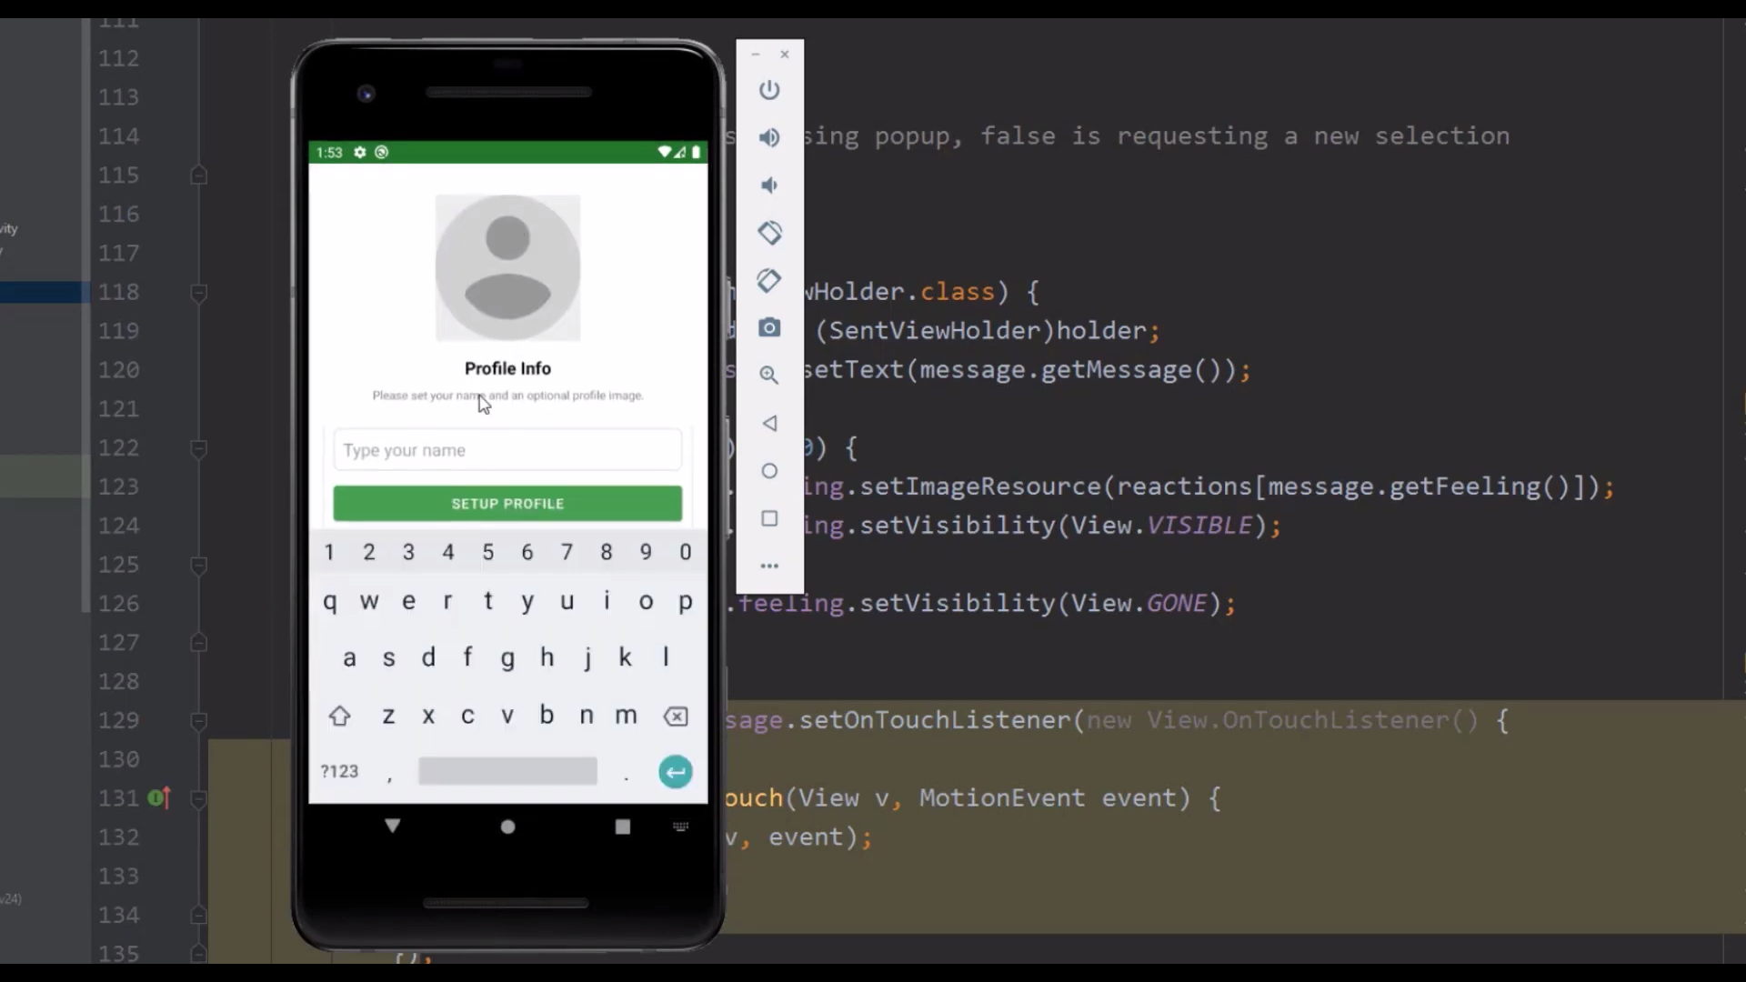
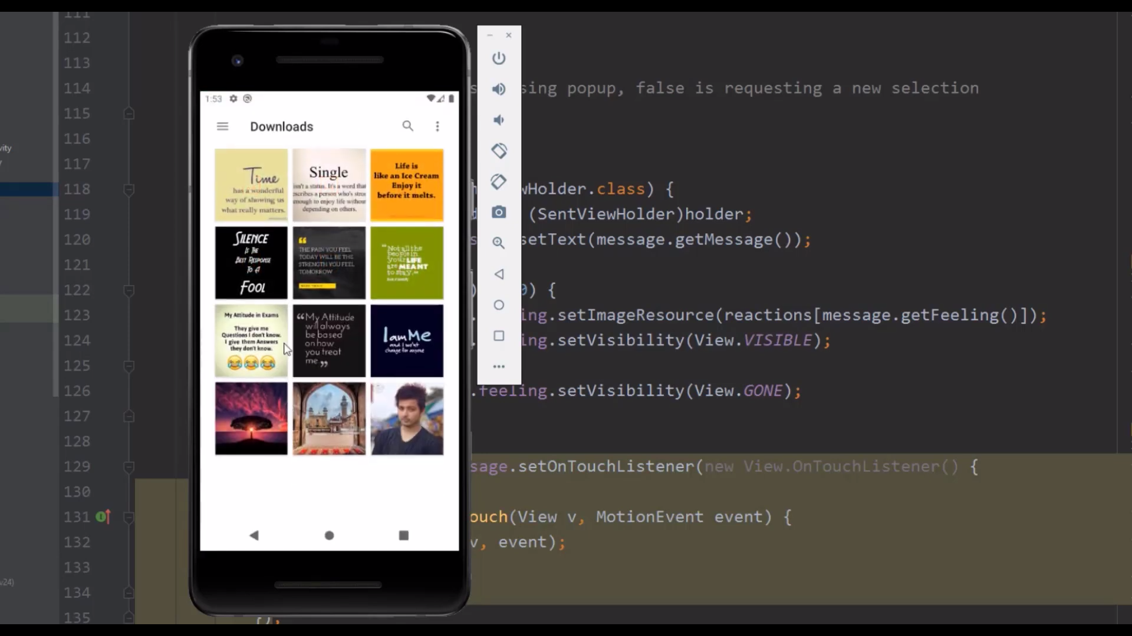
Now you have to setup your profile.
For adding profile pic click on the Person icon and browse for adding profile pic.

Slide 5
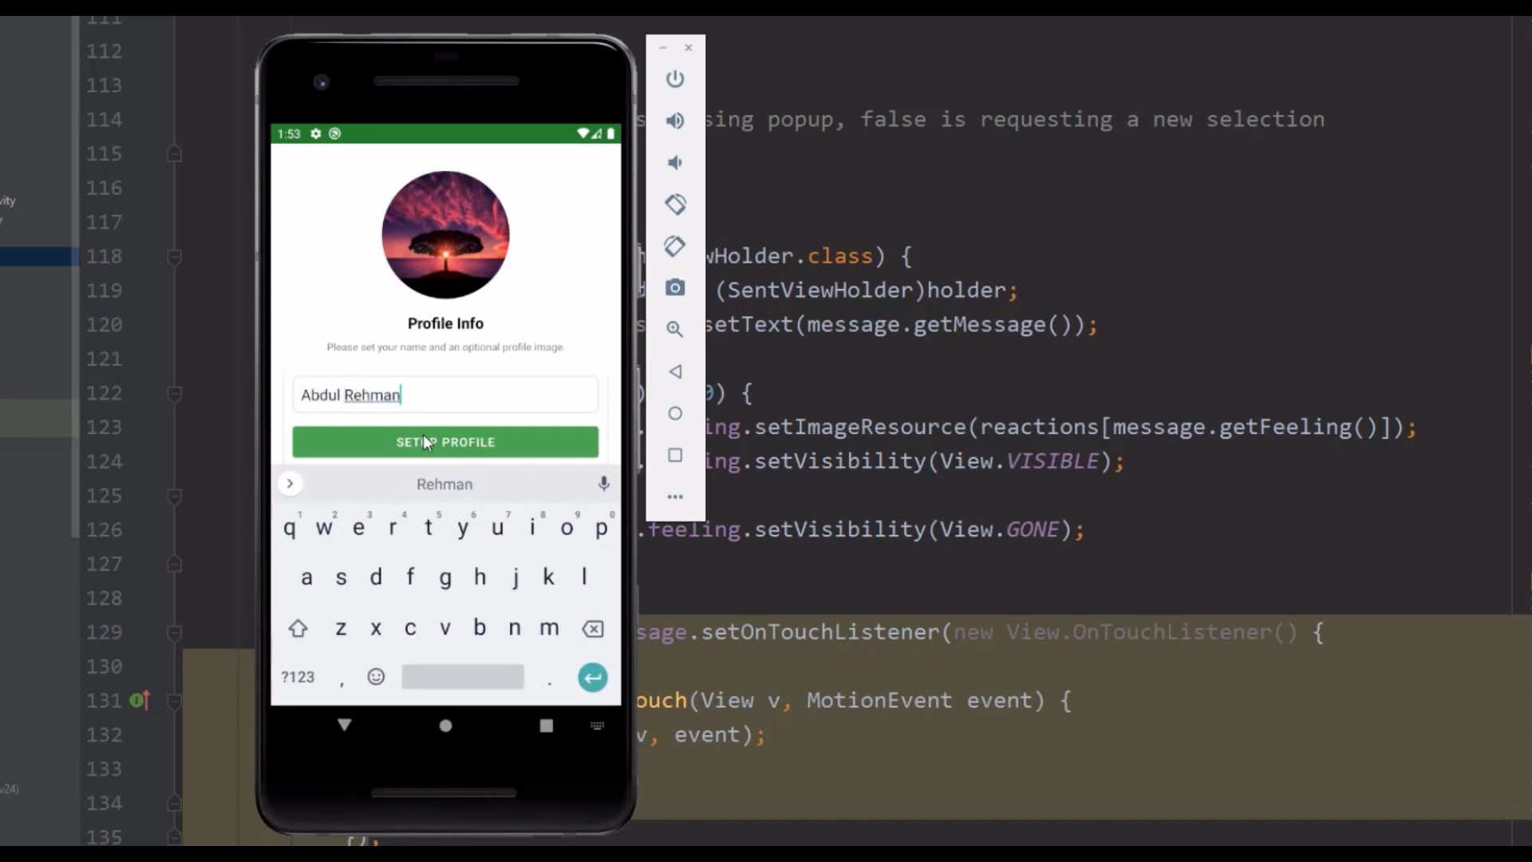
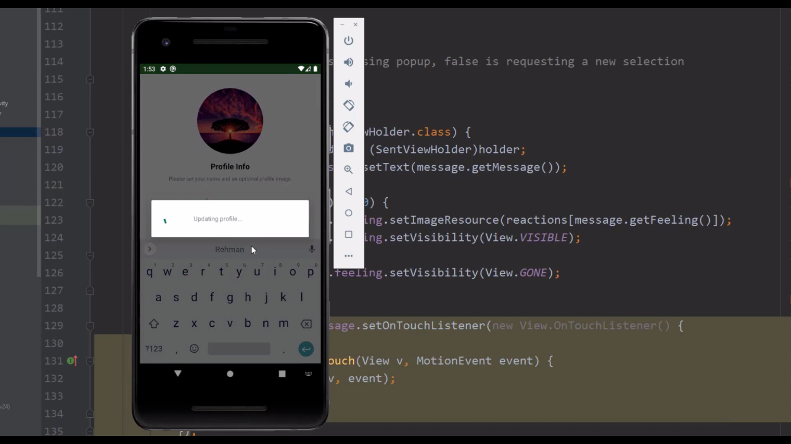
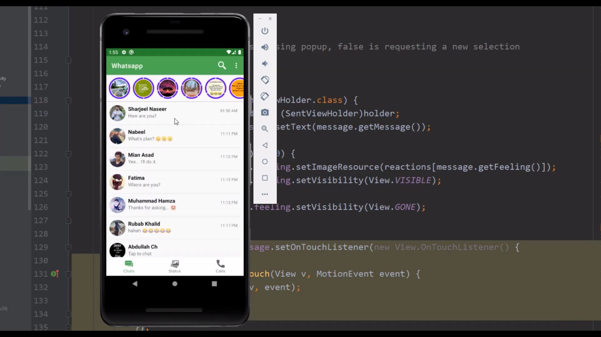
Click on the image of your choice and type your name. After that click on SETUP PROFILE button.
After loading, there you go you are ready for chatting

Slide 6
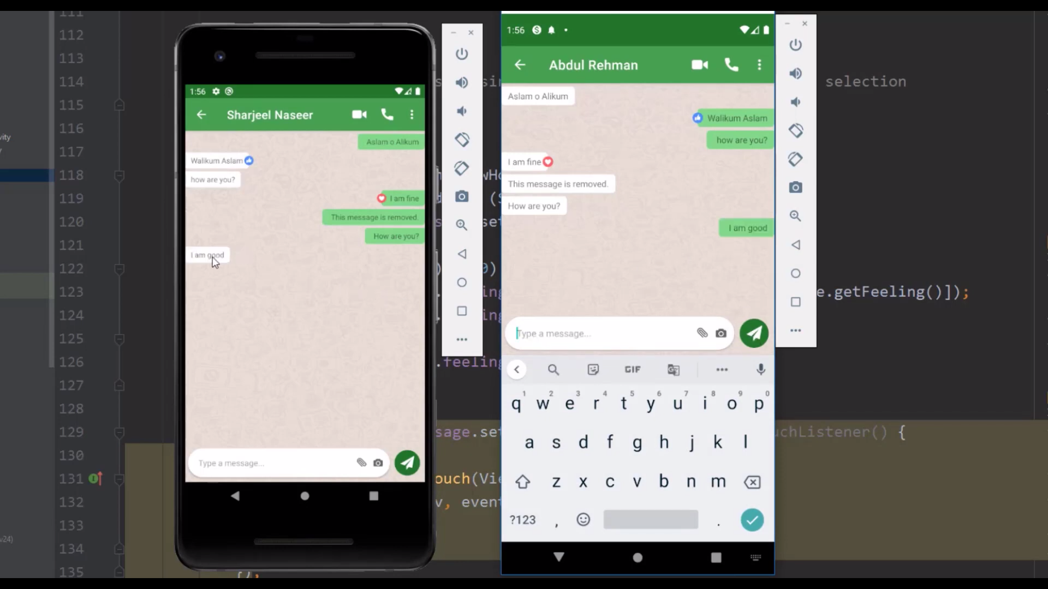
For sending messages, click on the person name you want to send and type the message you want.
Both User end screen

Slide 7
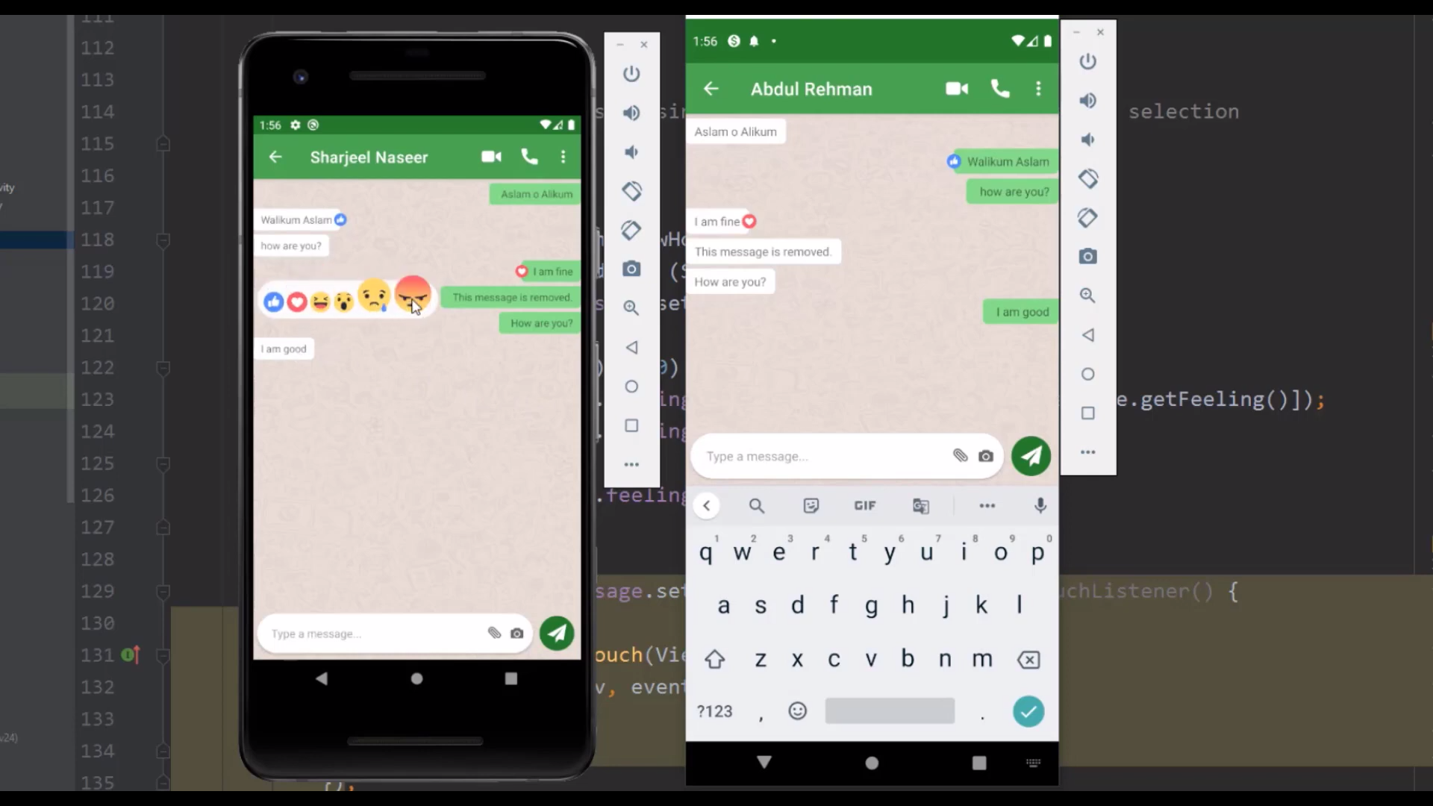

For adding feeling to a message, click on the message you sent and hover over and click to add emoji.

Slide 8
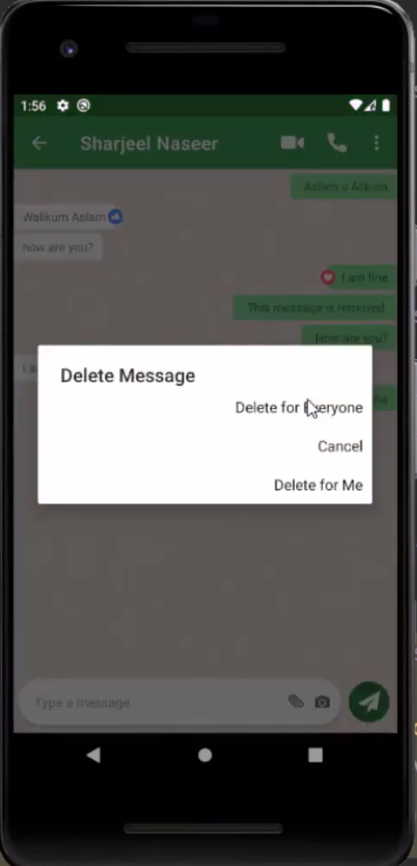
For Deleting any message, hold to the message you want to delete (doesn’t matter who sent the message) and delete as your choice.

Slide 9
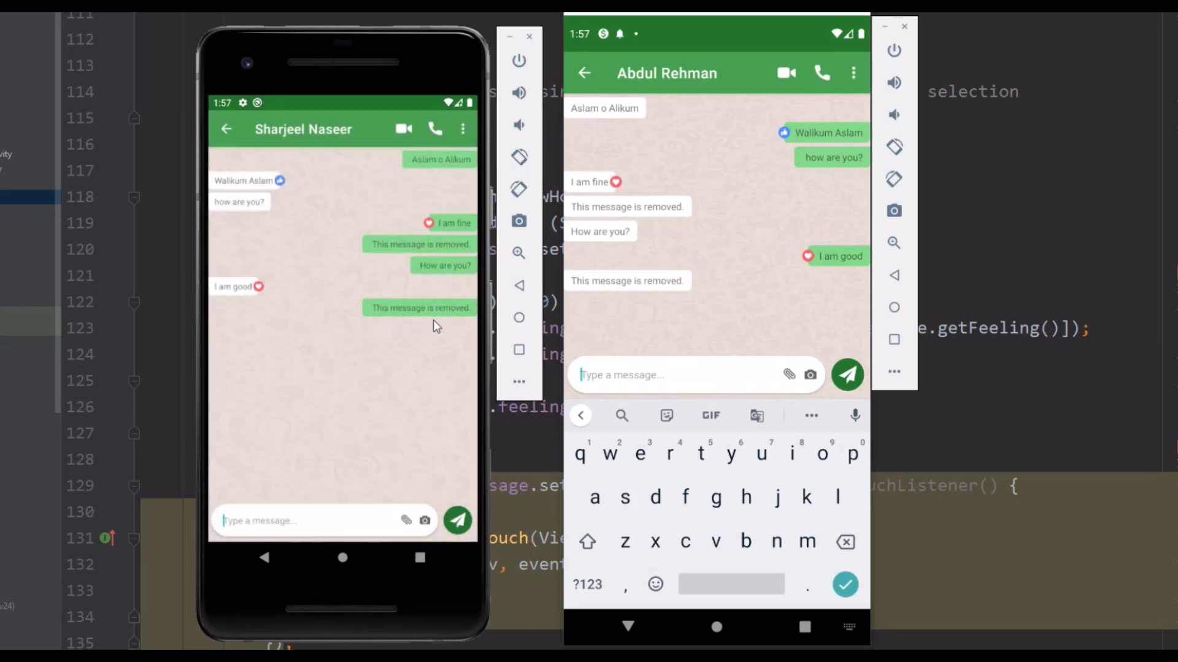

If you opt for “Delete for everyone”, “This message deleted” is shown to both the user attached to the chat.
Both User end screen

Slide 10


If you opt for “Delete for me”, ”This message is removed” is shown to the user only (who opt for deletion).
Both User end screen

Slide 11
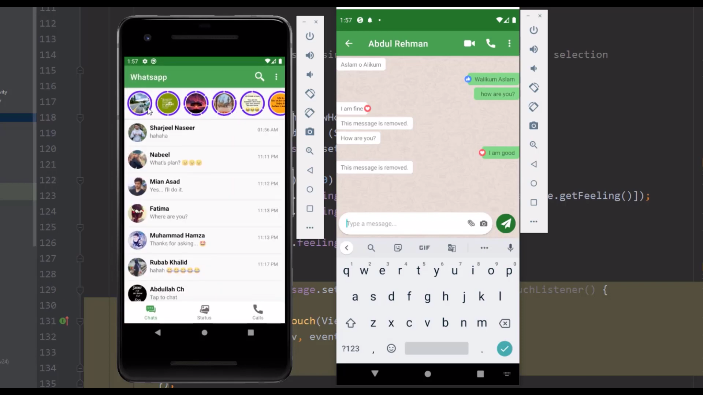
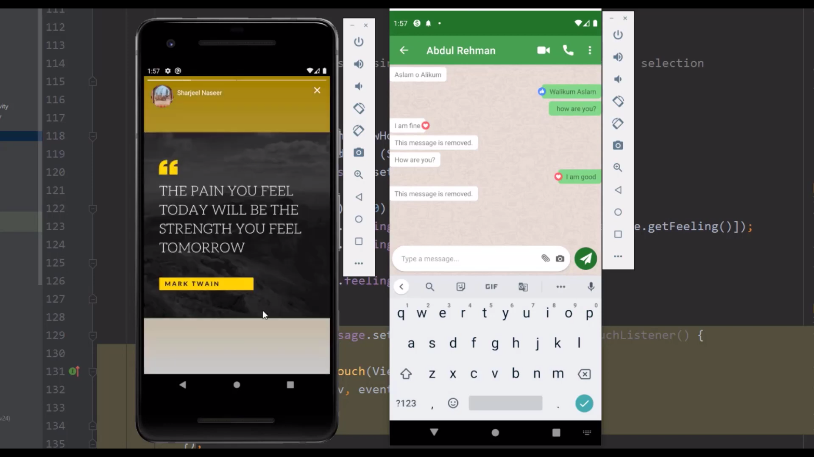
You can watch the stories that is provided by the person you chat. Click on any of them to view present at the top

Slide 12

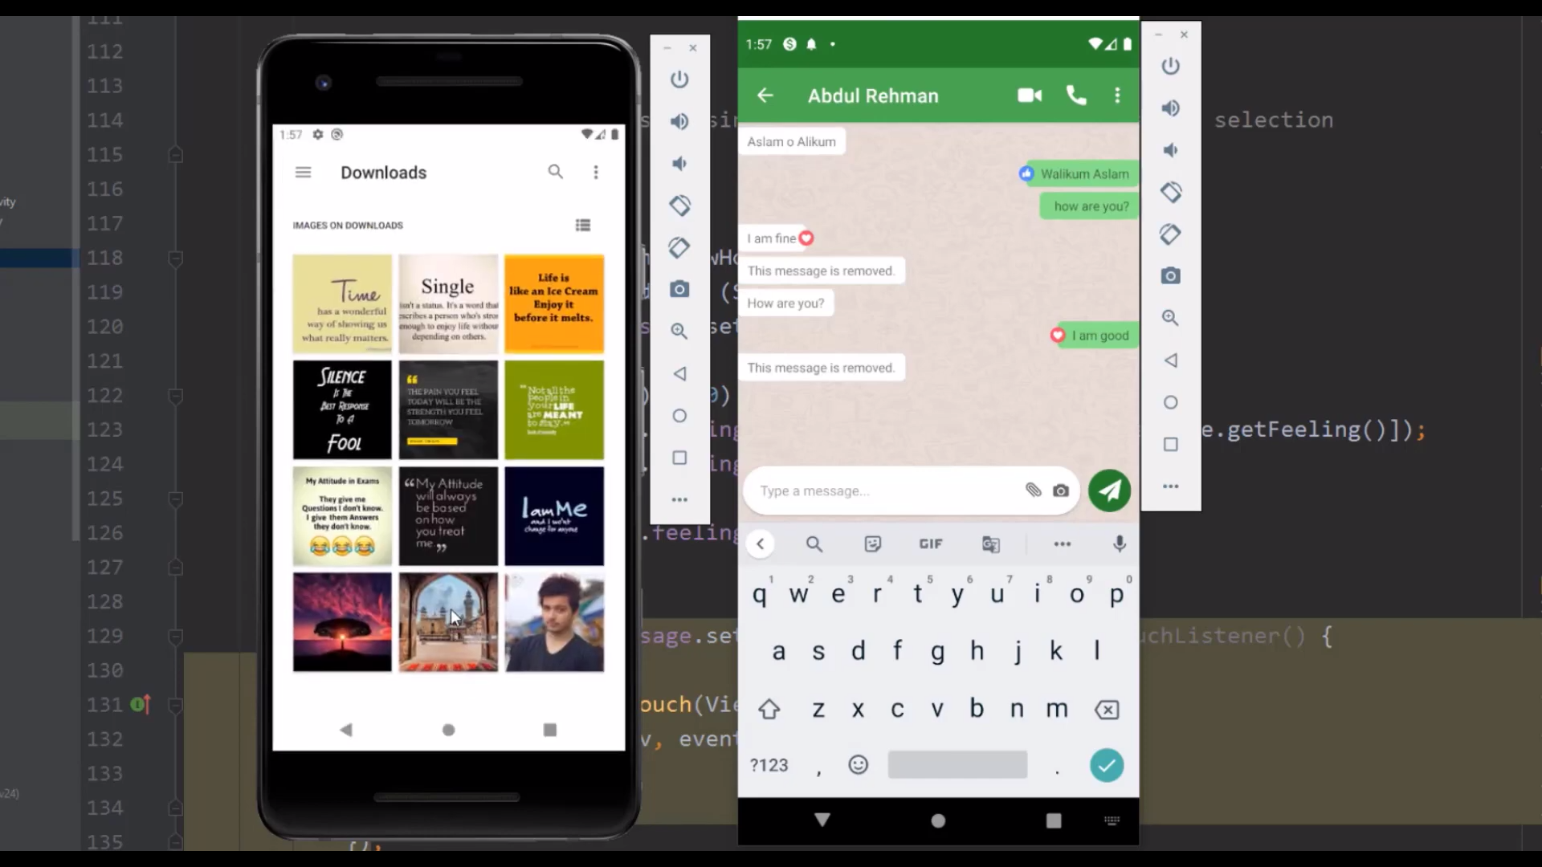
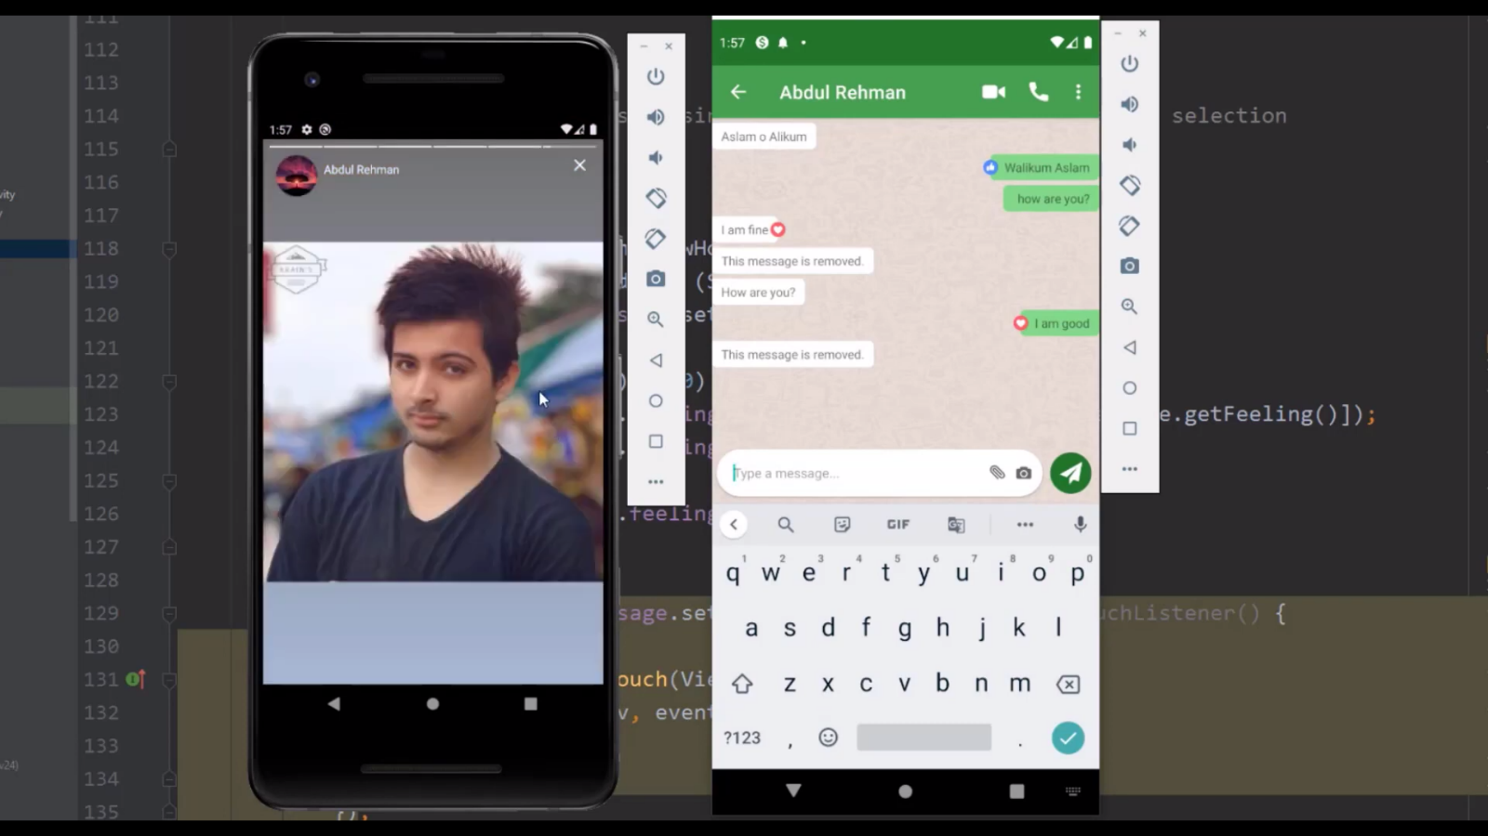
You can also add stories for yourself too. Click on the status tab at the bottom and then select the image. And you have added to your stories.

Slide 13
THANK YOU

